Slide 1
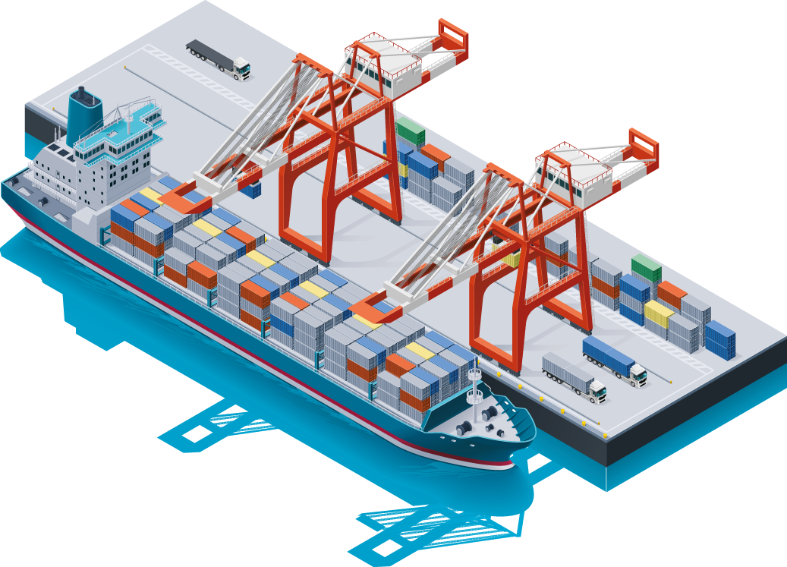


Container Orchestration
By: Jeremiah Gatong

Slide 2
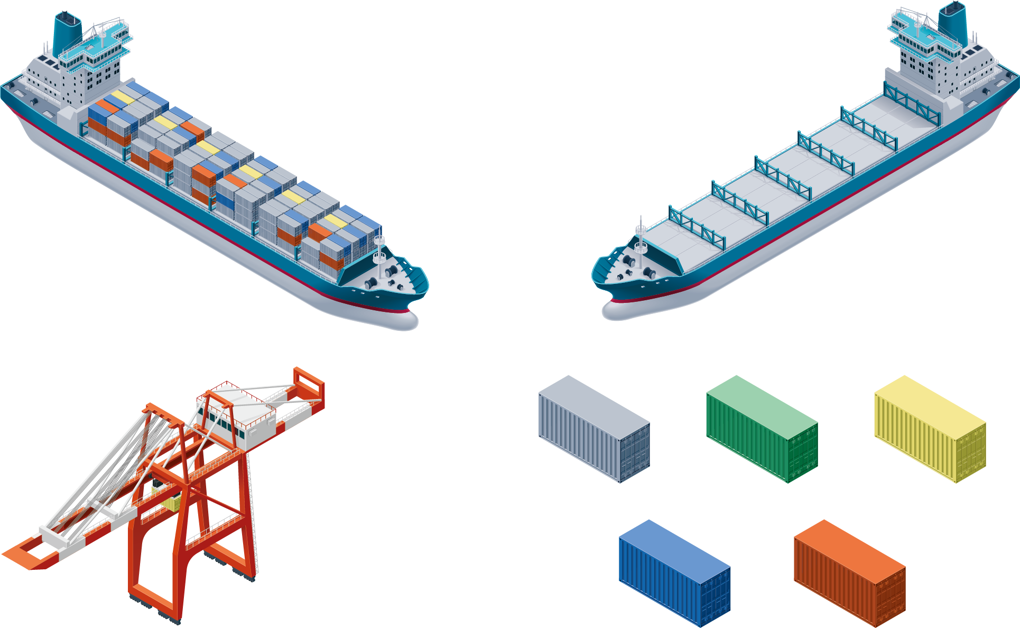
What is Container Orchestration?
Container orchestration - is the automation of all aspects of coordinating and managing containers. Container orchestration is focused on managing the life cycle of containers and their dynamic environments.
Used to automate the following tasks at scale:
• Configuring and scheduling of containers
• Provisioning and deployments of containers
• Availability of containers
• The configuration of applications in terms of the containers that they run in
• Scaling of containers to equally balance application workloads across infrastructure
• Allocation of resources between containers
• Load balancing, traffic routing and service discovery of containers
• Health monitoring of containers
• Securing the interactions between containers.

Slide 3

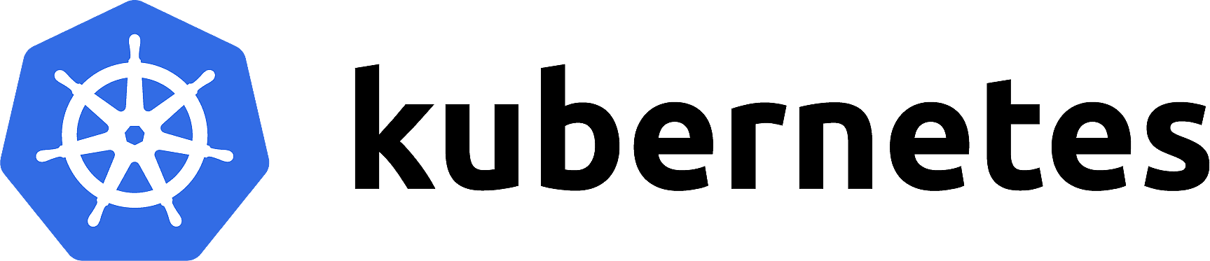
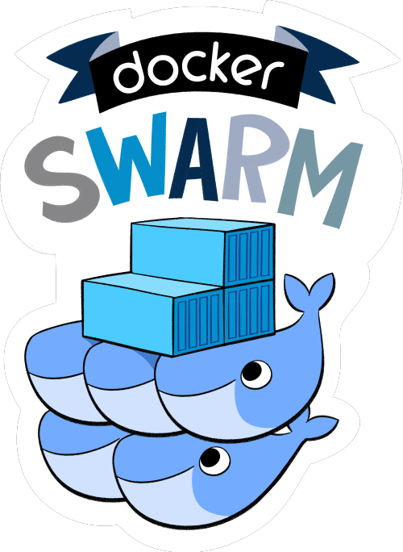

Orchestration Tools
Docker Swarm - Docker swarm is also a container orchestration tool, meaning that it allows the user to manage multiple containers deployed across multiple host machines.
K8s - Kubernetes is an open-source container orchestration tool. Kubernetes allows us to build application services that deploy multiple containers, schedule them across the cluster, scale those containers and manage the lifecycle of those Containers.
OCP - is Red Hat's enterprise Kubernetes platform. It's a comprehensive solution that offers developer and operational tools on top of Kubernetes.

Slide 4
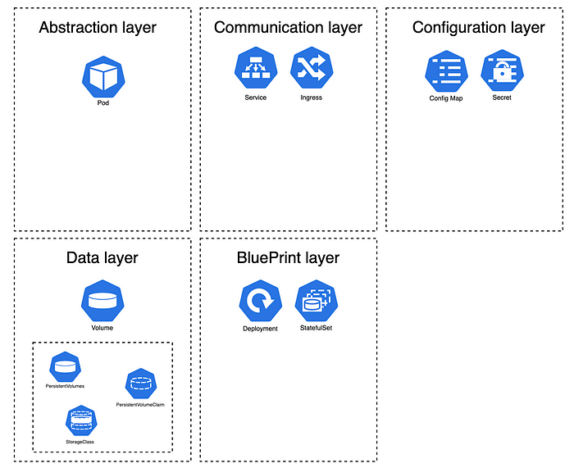
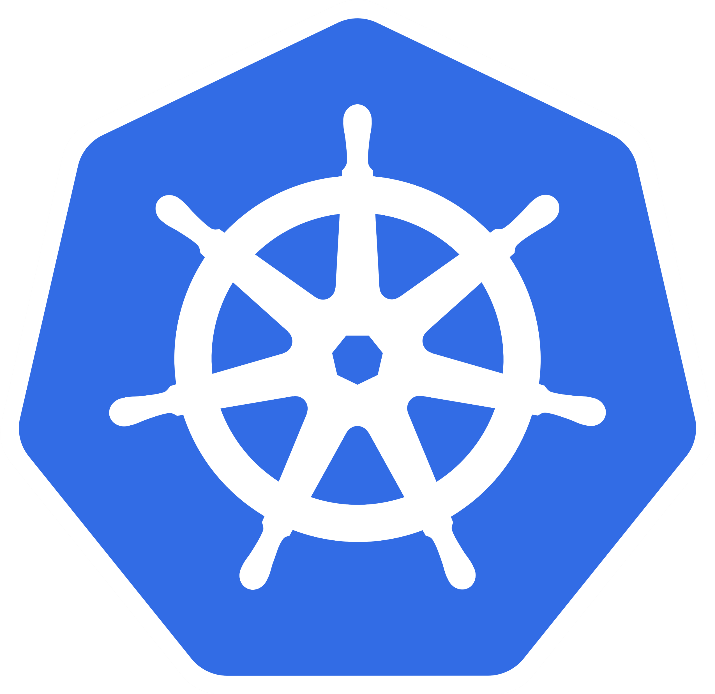
Kubernetes Components

Slide 5
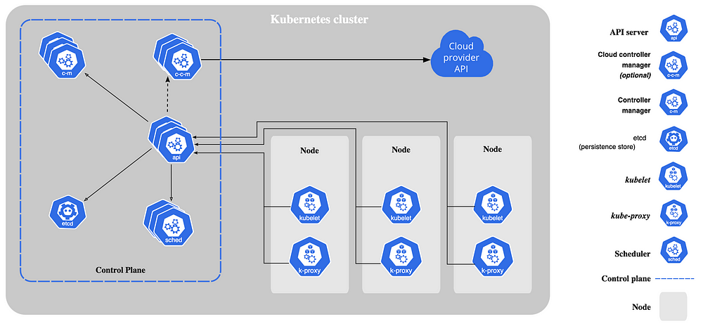
Kubernetes Architecture

Slide 6
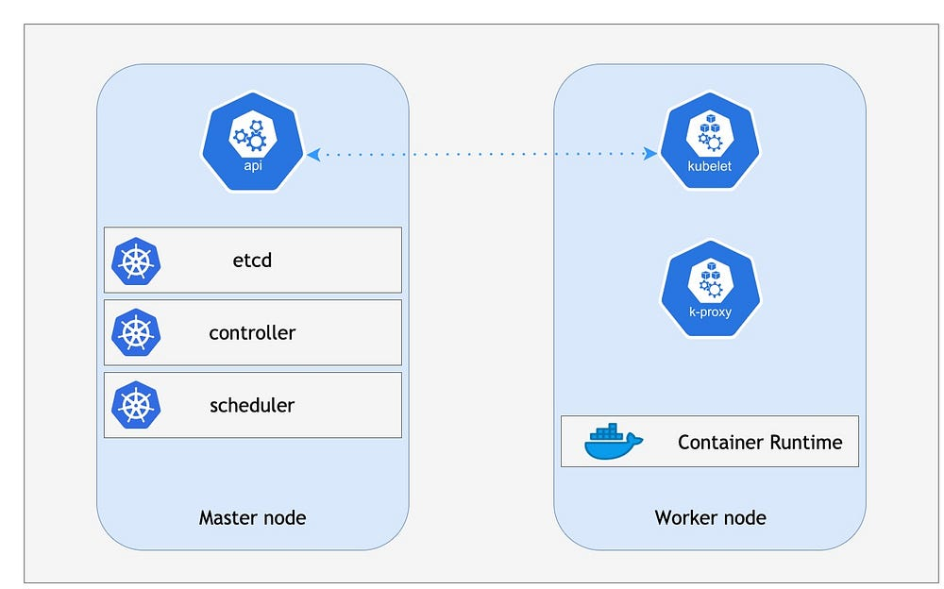
NODE
Master node
The scheduler is the component that is responsible for selecting the node that will be in charge of hosting our workload. The scheduler will select the node based on resource utilization, taints, quotas, …etc.
The Control Manager is responsible for detecting the state changes of our workload. If a pod crashes, it will try to reschedule the pod to make sure we always have the desired number of pods running in our cluster. The control manager doesn’t schedule pods by itself, it will reach out to the scheduler to delegate that task.
Etcd is a key-value pair storage that stores the status of our various Kubernetes components
The APi server is a very important layer because it allows us to deploy our workload utilizing the HTTP request or kubectl ( that is interacting with the API)
Worker node
Kubelet: Once the scheduler has identified the node to run our workload, kubelet is in charge of allocating resources and running our pods. It is also responsible for validating that our pods are ready and healthy. Kubelet will report any state changes of our pod to the control manager.
Kube-proxy is the component in charge of the communication between services.
Container runtime: since Kubernetes orchestrates containers within your cluster, the node needs to have a container runtime. Most of us use the docker runtime.

Slide 7
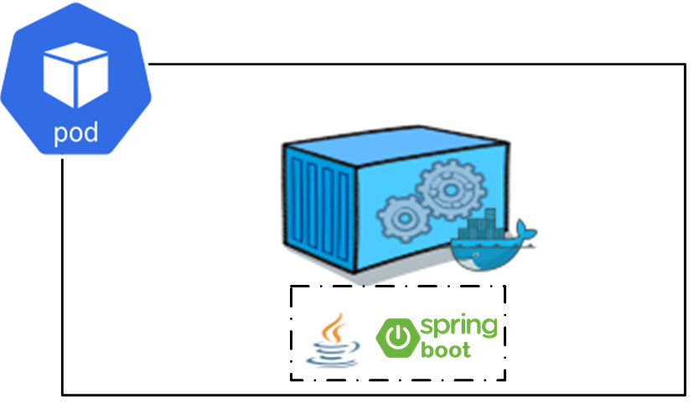
PoD
Smallest unit of Kubernetes, provides abstraction over a container. Creates a running env/layer on top of the container. Usually runs only one application container but can run multiple as well.

Slide 8
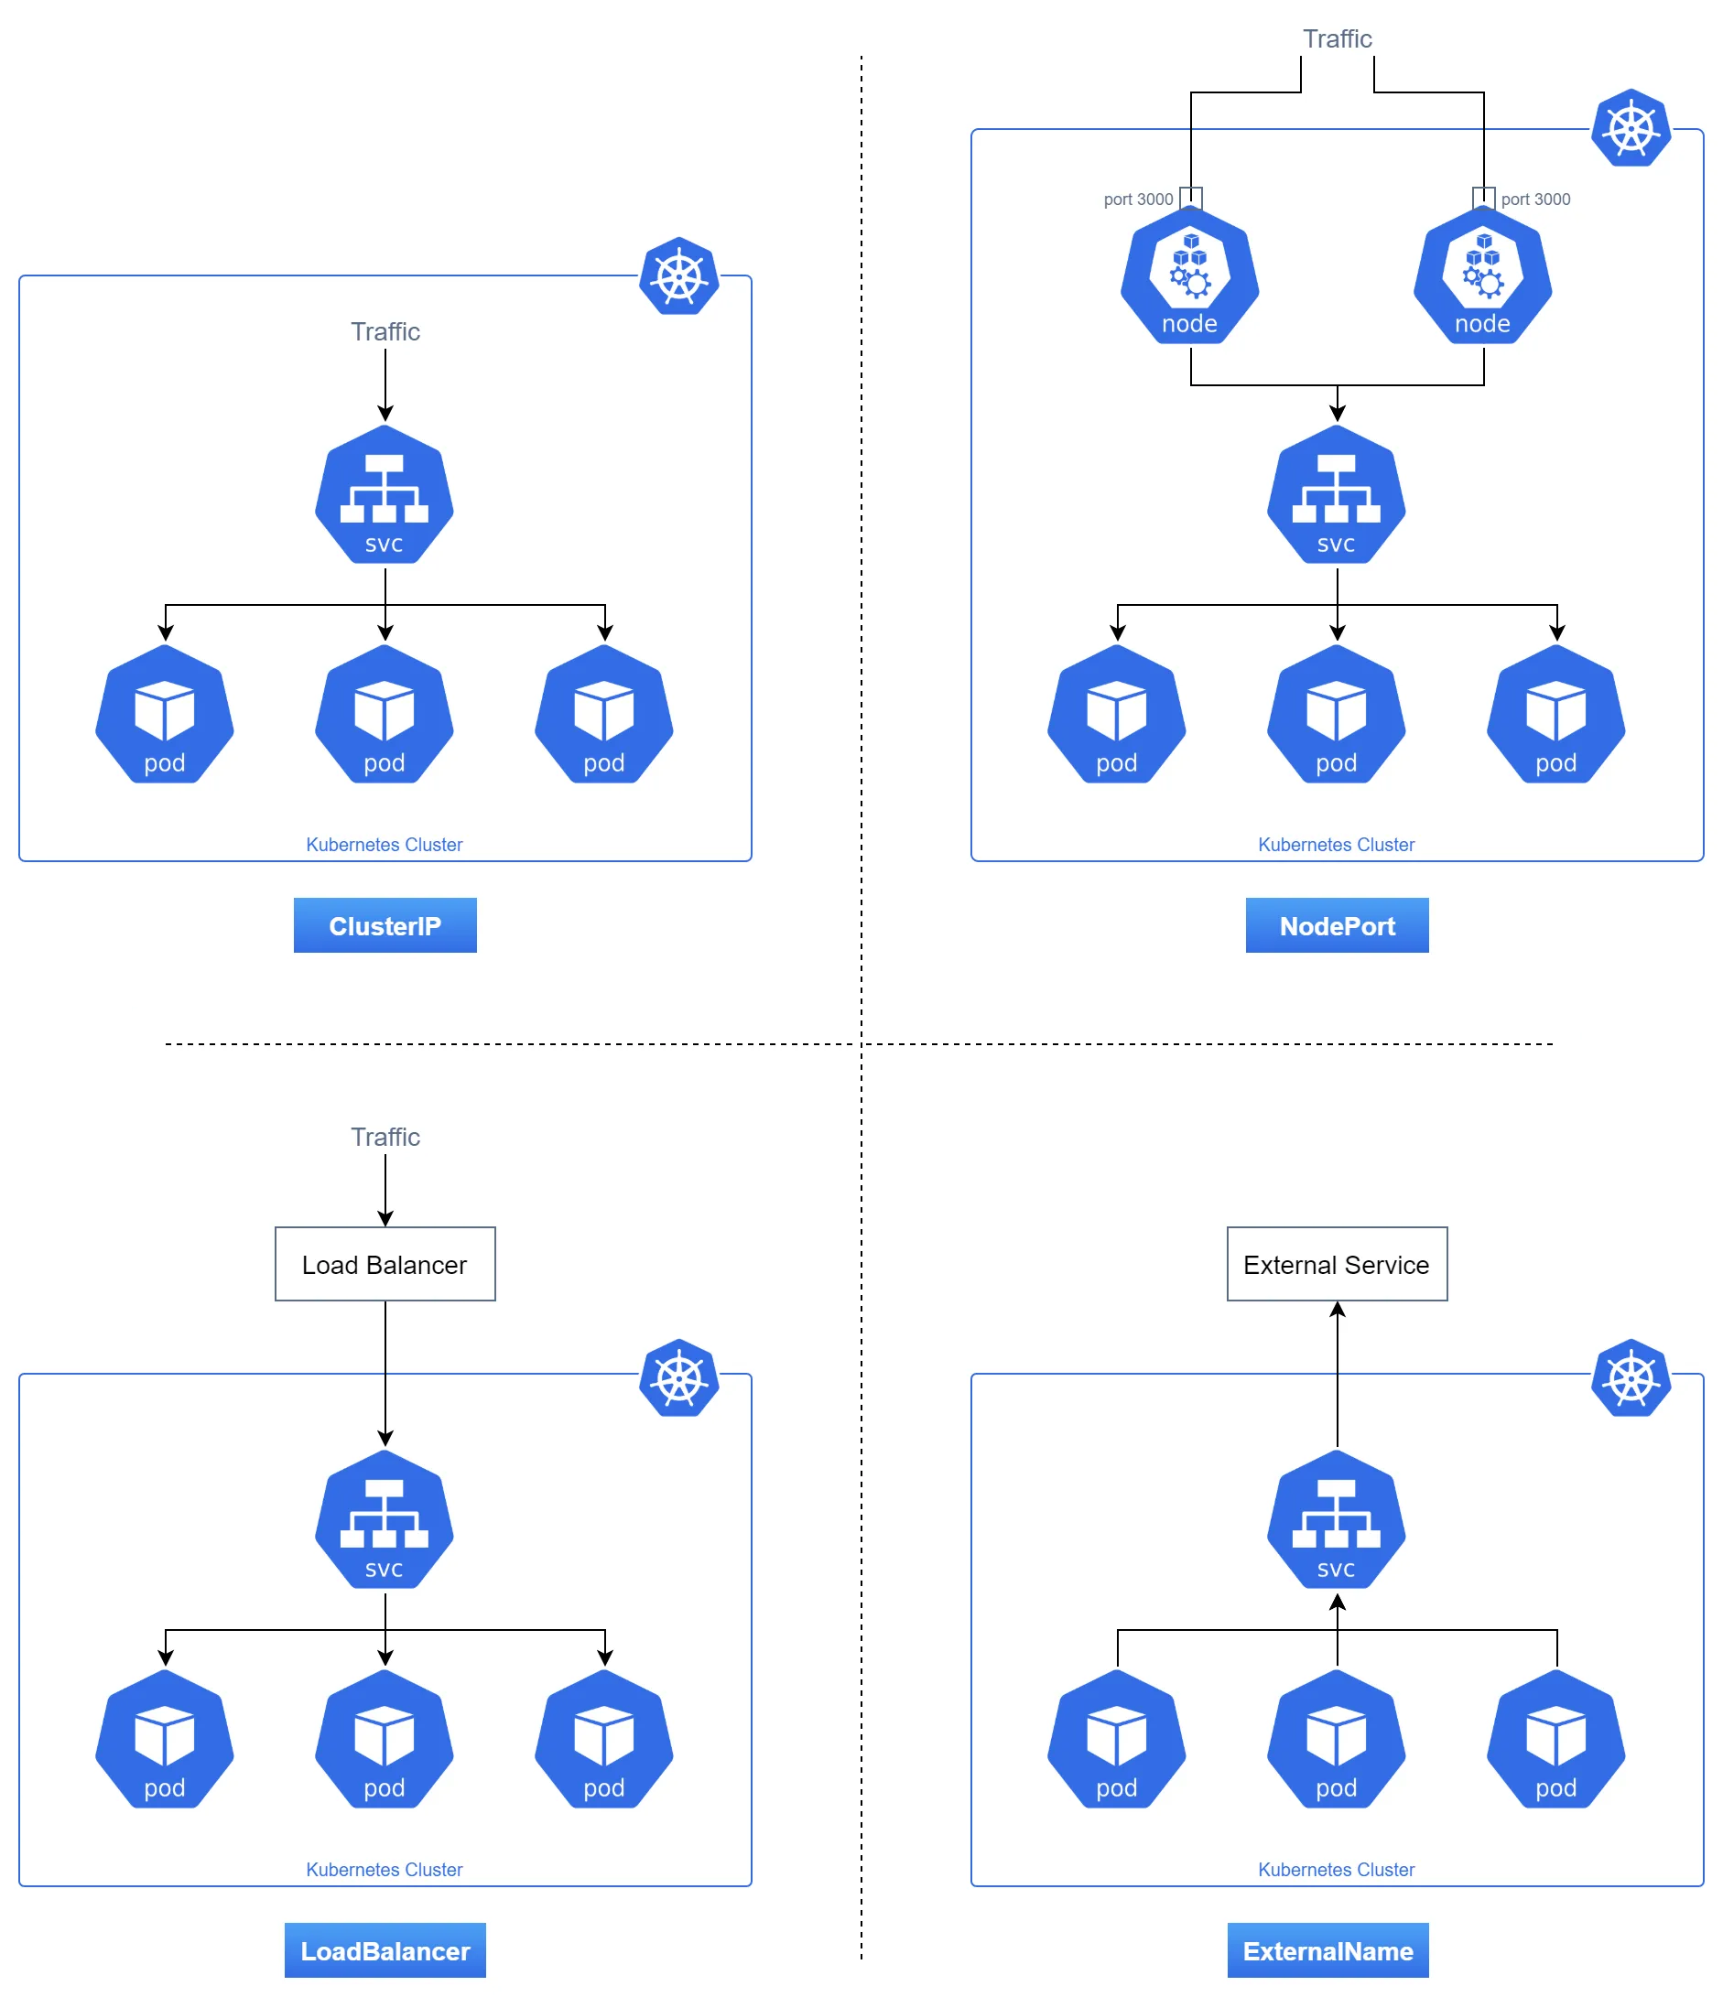
SERVICE
manage the network access to the Pods.
ClusterIP is the default and is for internal communication within the cluster.
NodePort is for exposing services using NAT, accessible via any node's IP and the designated port.
LoadBalancer is for cloud environments and provisions an external IP using the cloud provider's load balancer.
ExternalIP is for routing specific external IPs to services, assuming you've set up the routing yourself.

Slide 9
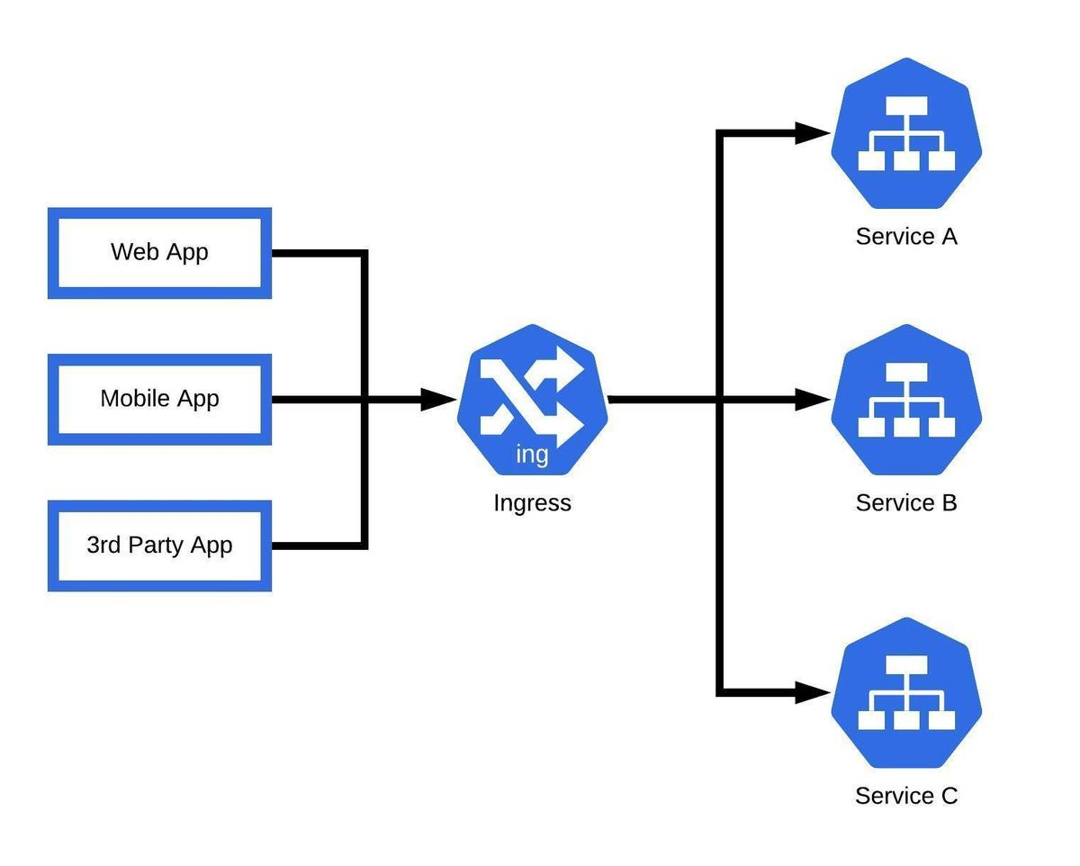
Ingress / ROUTES
Additional layer of security and address translation for services. All the requests first go to ingress then forwarded to the service.

Slide 10
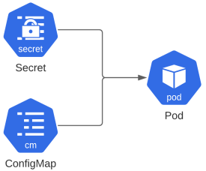
CONFIGMAP & Secrets
ConfigMap: External configuration of your app like urls of database or other services.
Secret: To store secret/sensitive data like db-credentials, etc., encoded in base_64 format.

Slide 11
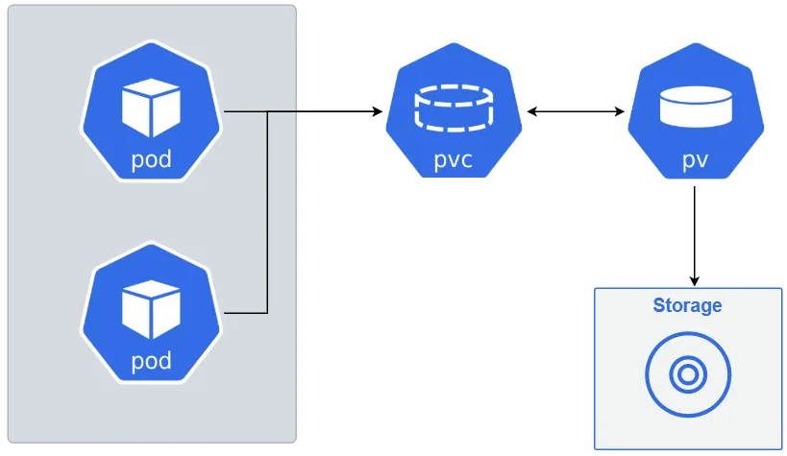
VOLUMES
are used to persist data generated by pods. It attaches a physical storage to the pod that can be both local or remote like cloud or on-premise servers.
Persistent volume is a piece of storage provisioned for use in the cluster.
Persistent Volume Claim is a request for and claim to a piece of that storage.

Slide 12
DEPLOYMENTS
manages a set of Pods to run an application workload, usually one that doesn't maintain state
Rolling Update: This is the default strategy for Deployment updates. It incrementally replaces old Pods with new ones. You can control the speed of the rollout using the maxSurge and maxUnavailable fields.
Rollback: If something goes wrong during a rollout, you can roll back to a previous version of the Deployment.

Slide 13

OpenShift

Slide 14
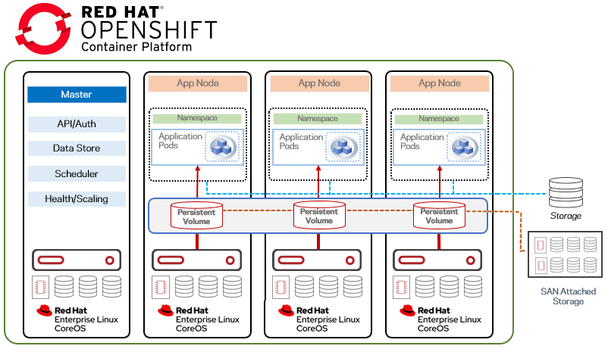

Slide 15
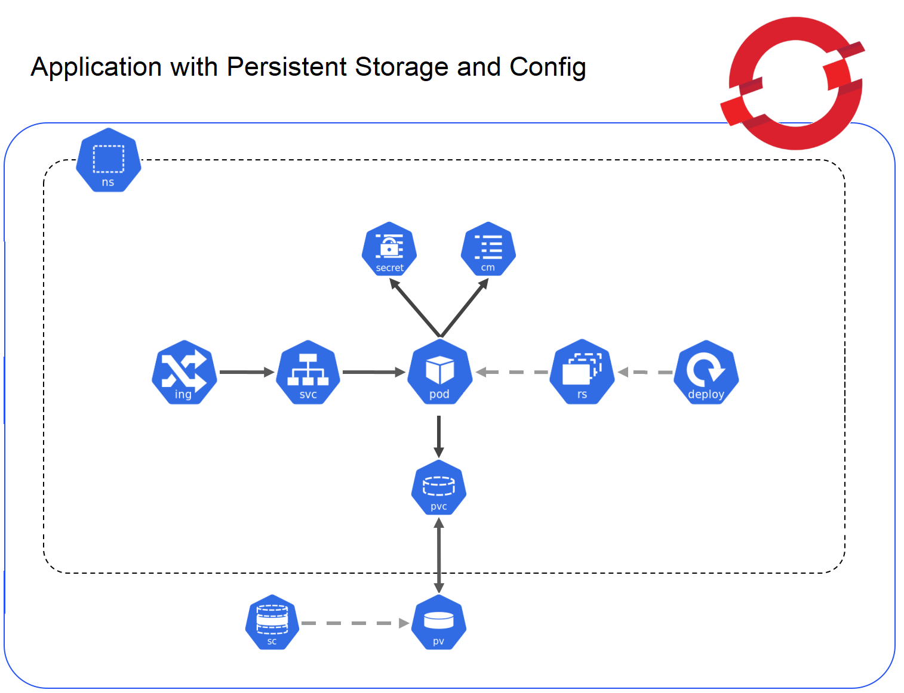
Demo

